Slide 1

Image Processing in Robotic Simulation
Robo Carnival 2023

Slide 2
Remote API
CoppeliaSim has support for web-socket based remote APIs for Python, MATLAB, C/C++, Java, Octave
We can use remote APIs to run external code scripts to control robots via these languages
This is useful because Python has rich libraries for planning, computer vision and machine learning / deep learning
In this part, we will see the use of OpenCV in Python for making a vision based robot that will be able to play soccer.

Slide 3
Using Python Remote API
Python remote API documentation is a mandatory reference for us to find the necessary functions: https://www.coppeliarobotics.com/helpFiles/en/remoteApiFunctionsPython.htm
We need to copy some files to the source directory of the python script/notebook
C:\Program Files\CoppeliaRobotics\CoppeliaSimEdu\programming\legacyRemoteApi\remoteApiBindings\lib\lib\Windows\remoteApi.dll
C:\Program Files\CoppeliaRobotics\CoppeliaSimEdu\programming\legacyRemoteApi\remoteApiBindings\python\python\sim.py
C:\Program Files\CoppeliaRobotics\CoppeliaSimEdu\programming\legacyRemoteApi\remoteApiBindings\python\python\simConst.py

Slide 4
Vision Sensor Functions
returnCode, resolution, image = simxGetVisionSensorImage(clientID, sensorHandle, options, operationMode)
- This function will return the actual image sent by the sensor. Useful for full resolution images.
- resolution is an array containing the resolution of the returned image as set in the simulation
- image is an array object that will contain the image data
- options for receiving image, grayscale/RGB
- operationMode: for the first time this function is called, it should be set in streaming mode to let the simulator know that we will be receiving stream of information. For the consecutive calls, it should be buffer mode.

Slide 5
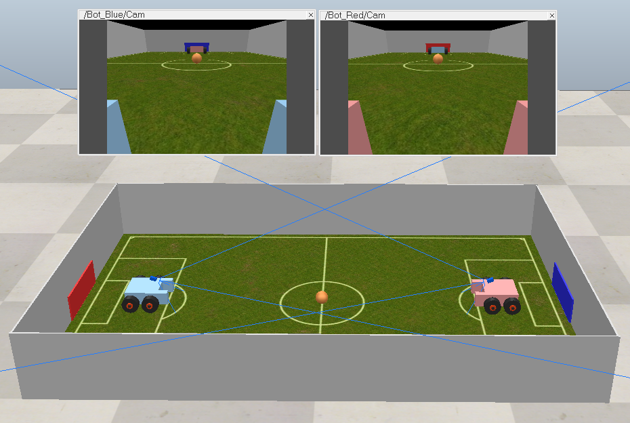
Soccer Bot

Slide 6
Getting Images from Robot
During initialization, simxGetVisionSensorImage() has to be called with “streaming” option once:
err, res, image = sim.simxGetVisionSensorImage(clientID, camHandle, 0, sim.simx_opmode_streaming)
0 for color image
1 for grayscale

Slide 7
Getting Images from Robot
During loop, simxGetVisionSensorImage() has to be called with “buffer” option:
err, res, image_raw = sim.simxGetVisionSensorImage(clientID, camHandle, 0, sim.simx_opmode_buffer)
The raw image data is an unpacked array of pixel values in the red, green and blue channels.
Resolution is a list of image dimensions (width, height)
We need to reshape the unpacked array into the dimensions to get a proper image.
img = np.array(image_raw, dtype=np.uint8) ➔ data type conversion
img.resize([res[1], res[0], 3]) ➔ reshaping array
img = img[::-1,::-1, :] ➔ rotate by 180 degrees

Slide 8
Head Over to the Code!
Soccerbot.ipynb notebook contains the code for soccer bots in soccerbot.ttt
To open the notebook:
Open the command line (cmd.exe - windows)/ terminal window (linux) in the notebook directory
Activate the conda environment by typing “conda activate env_name”
Start jupyter notebook by typing “jupyter notebook”
If you do not wish to use jupyter notebook, you can open the notebook in any other software (visual studio code/PyCharm) and copy the code to a .py file first.
Run the simulation first, and then run the python notebook / script to take control of the robot inside the simulation.

